Slide 1
My TTT on Big Data
By,
Sangeetha
29/11/2016

Slide 2
My Learning @ Glance
Basic Essentials:
Java Essentials:
Java Language fundamentals
Decision & Looping
File Streams-File Reading and Writing
String Handling
Generics and Collections
Exception handling
J2EE Essentials:
Introduction to Web Application
Servlets and JSP
Sample Applications
SQL:
Basic queries DDL/DML
Joins, Subquery, Aggregate functions

Slide 3
My Big Data TTT @ Glance
Intro Big Data and Hadoop
Hadoop 1.x Architecture and Ecosystem
Hadoop 2.x Architecture
Installation and Configuring Ubuntu /Hadoop/Putty/WinSCP
Hadoop MapReduce I and II
Installation and Configuring Cloudera
Understanding Hive, Hbase
Understanding Sqoop and Flume
Understanding Pig
Understanding Zookeeper and Oozie
Completion Project 1 E-Commerce
Completion Project 2 Census data

Slide 4
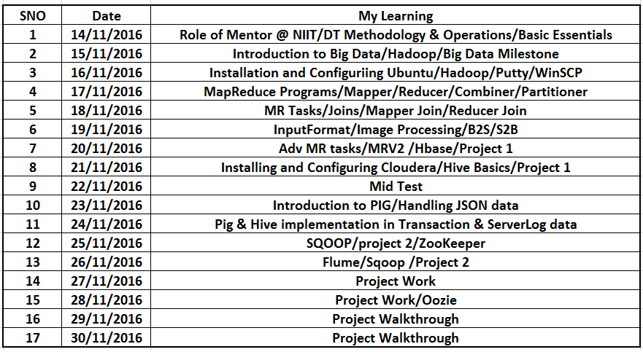
My Training Milestone

Slide 5
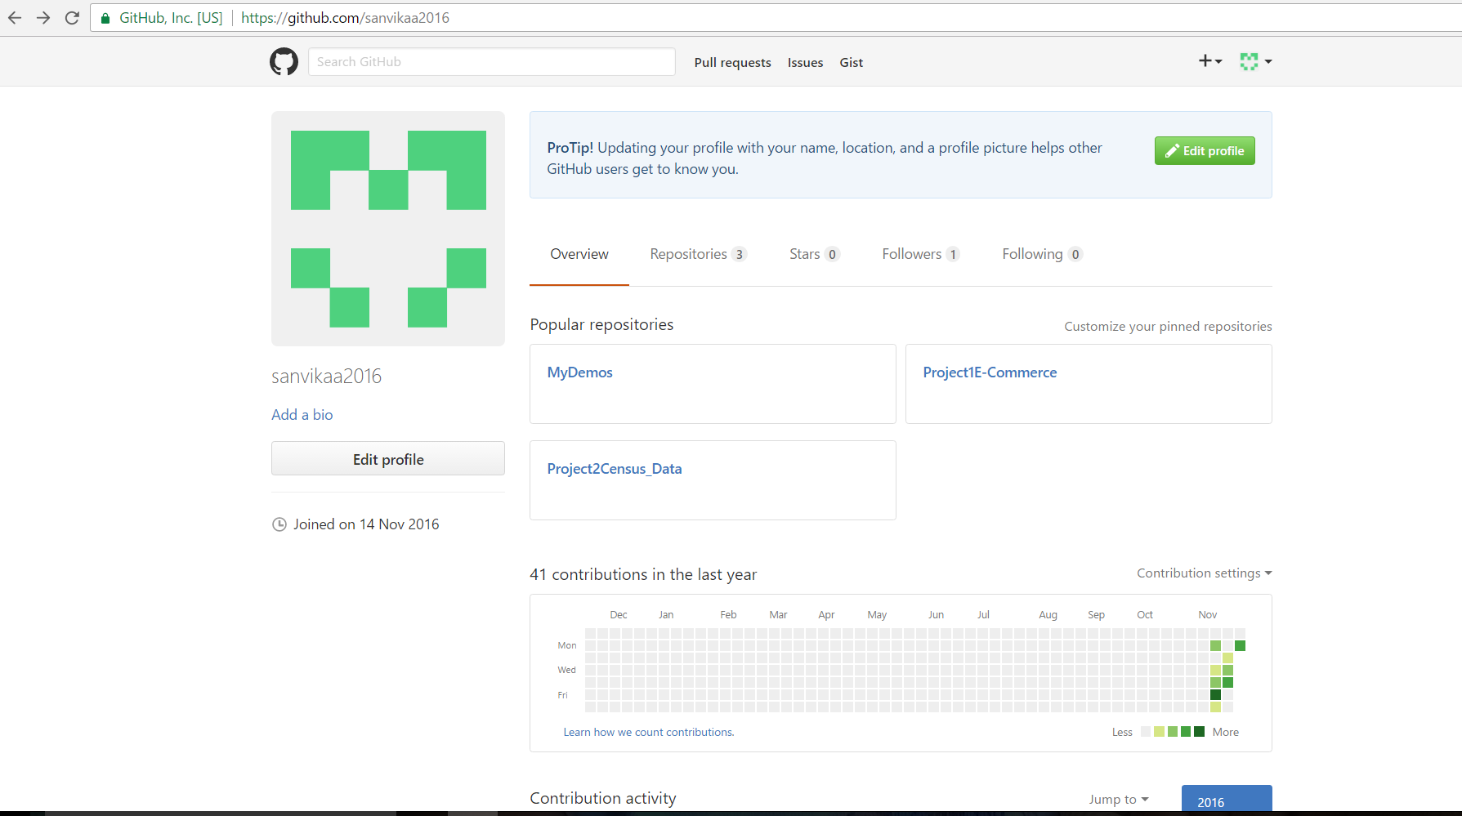
My GITHUB LINK: https://github.com/sanvikaa2016

Slide 6
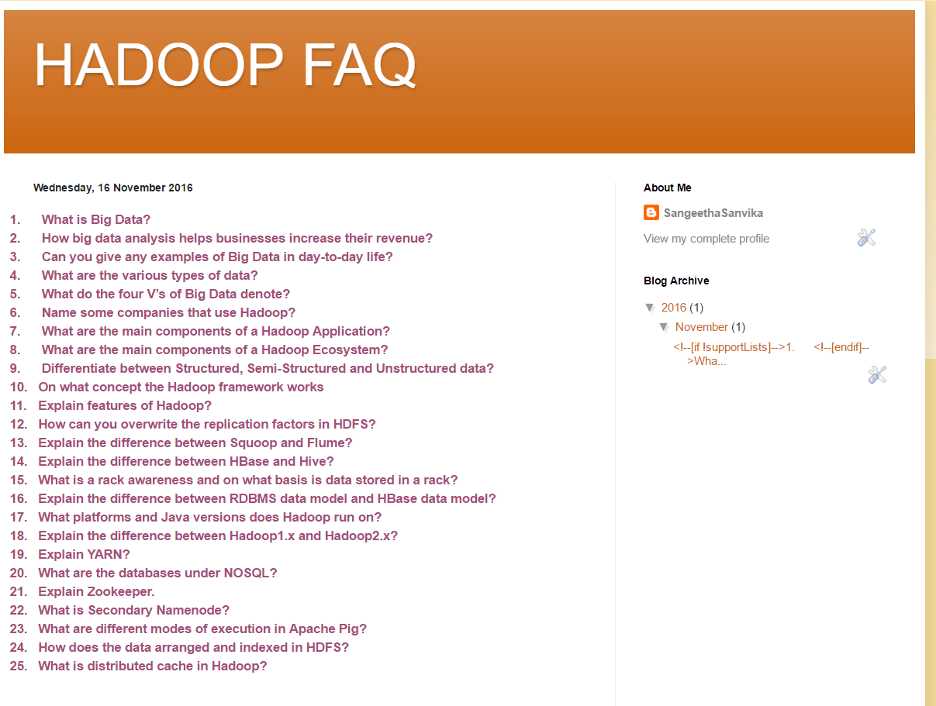
My FAQ blog http://sanvikahadoopfaq.blogspot.in/

Slide 7
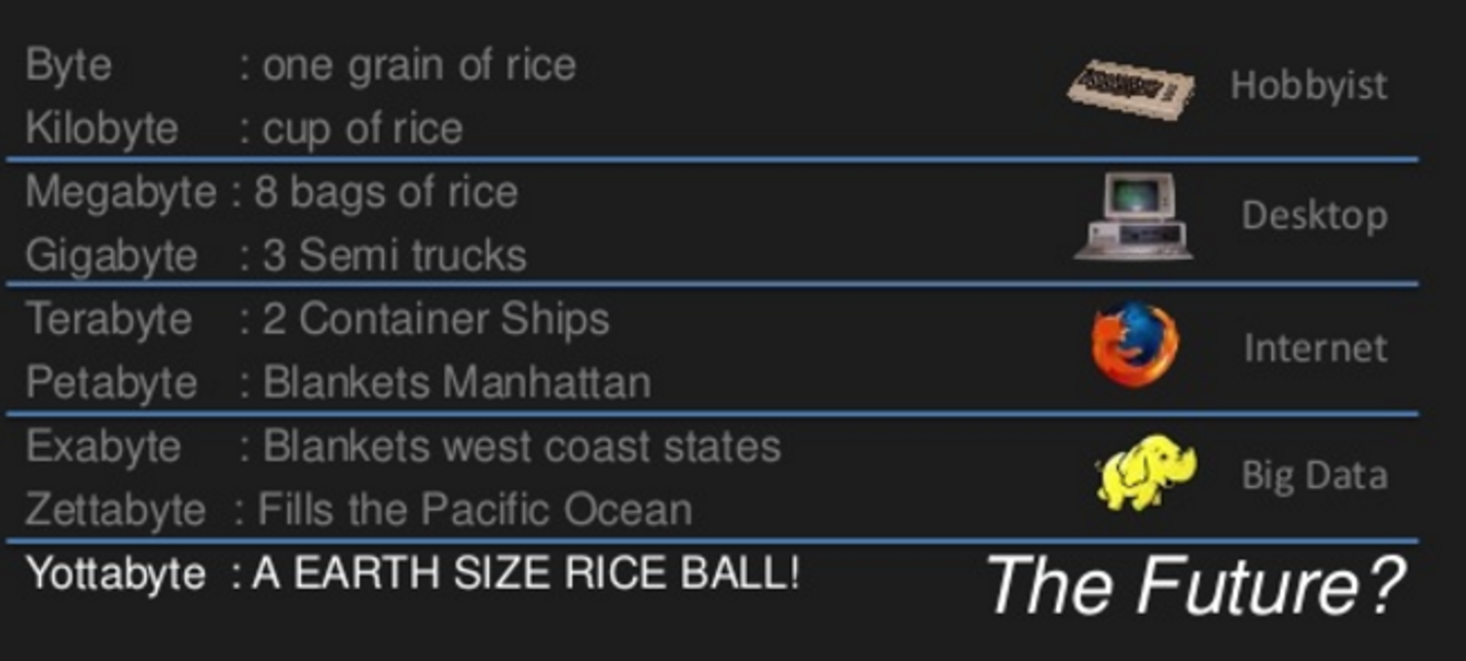
Data….

Slide 8
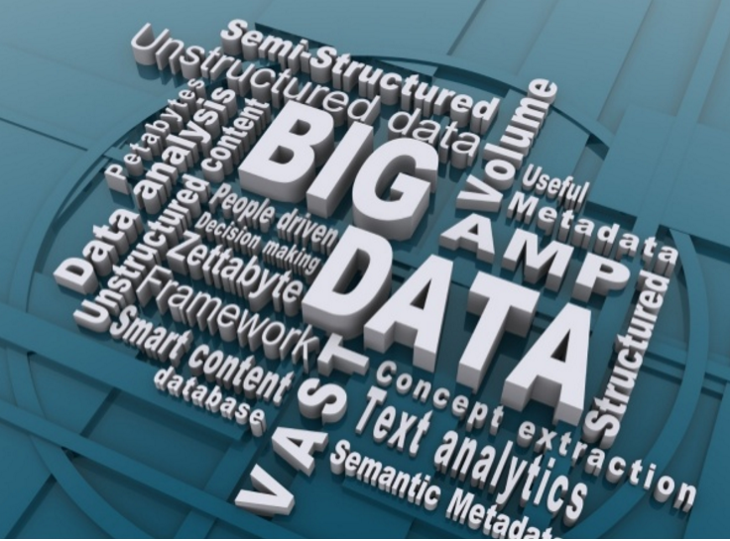

Slide 9
Big Data(What it means to us?)

Slide 10






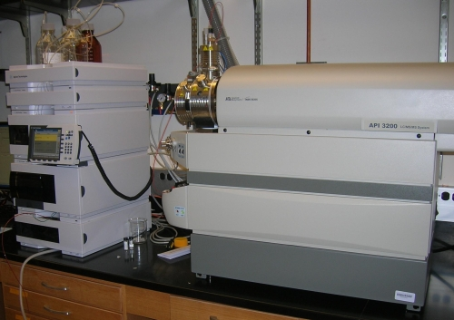
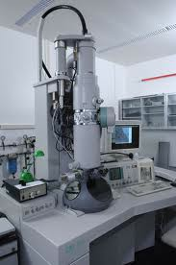
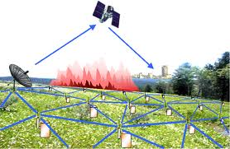

Who’s Generating Big Data
Mobile devices
(tracking all objects all the time)
Social media and networks
(all of us are generating data)
Scientific instruments
(collecting all sorts of data)
Sensor technology and networks
(measuring all kinds of data)

Slide 11
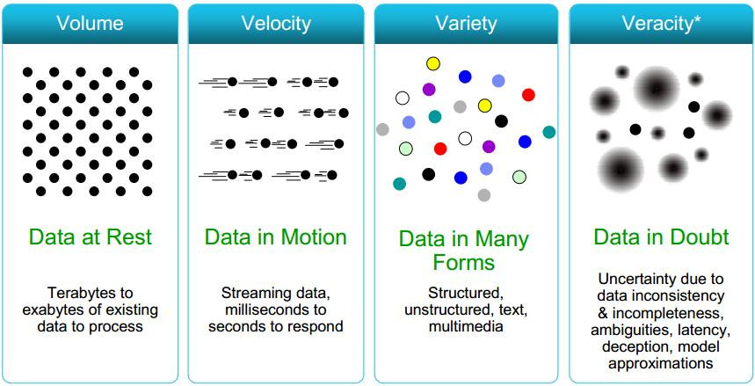
Big Data 4V’s

Slide 12
Who uses big data?
Banking
Education
Government
Health Care
Manufacturing
Retail

Slide 13
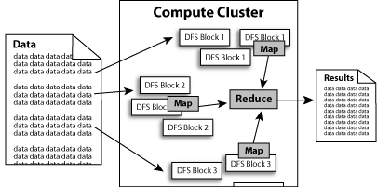
What is Hadoop?
Software platform that lets one easily write and run applications that process vast amounts of data. It includes:
– MapReduce – Computing engine
– HDFS – Hadoop distributed file system
Features: Scalable/Economical/Efficient/Reliable

Slide 14
Other Hadoop Tools
Hive
Hadoop processing with SQL
Pig
Hadoop processing with scripting
Sqoop
Import and Export Tool
HBase
Database model built on top of Hadoop
Flume
Designed for large scale data movement

Slide 15
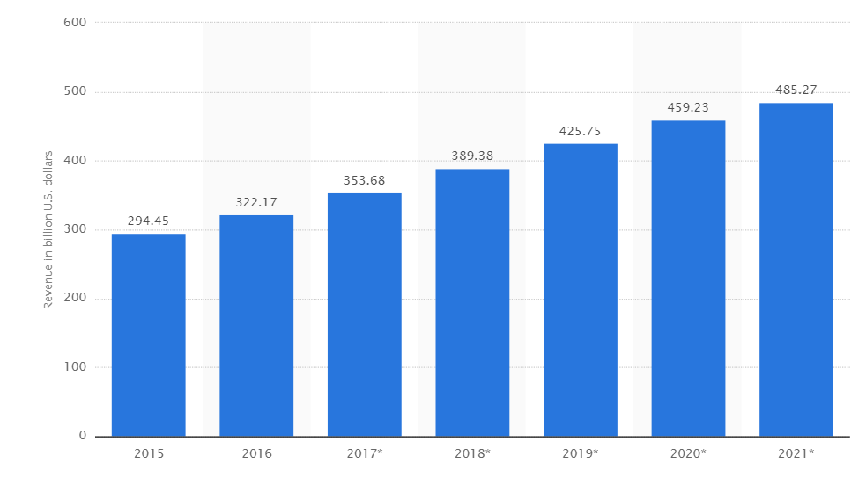
Top 10 E-Commerce sites in the world based on visitors
1.Amazon
2.Taobao
3.E-bay
4.Tmall
5.Alibaba
6.Flipkart
7.Walmart
8.Snapdeal
9.Bestbuy
10.Jabong

Slide 16
Project 1 Data Analysis on Socio-Economic and Well-being Fitness

Slide 17
Objective:
The project is based on Data Analysis for Economy, Seasonality, Product selling, Financial exchange, Well-being Fitness and Sports interest.
This project would help in analyzing socio-economic status, their wellbeing fitness on various factors like age group and period of time, etc.

Slide 18
Given Data: Sports & Fitness Equipment sales details and Customer details
Trans id | Date | Cust id | Amount | Category | Item name | City | State | Mode of payment
Cust id | First Name | Last Name | Age | Profession

Slide 19
HARDWARE & SOFTWARE REQUIREMENTS:
Operating System : LINUX
RAM : 8GB
System Type : 64 bit OS
Software Framework : Hadoop
Development Tool : Eclipse
Language Used : MapReduce Java, Hive, Pig

Slide 20
Use Case Analysis on following factors:
Economic Status
Seasonality
Financial Exchanges
Wellbeing Fitness
Sports Awareness

Slide 21
1. Economic Status:
Economic Analysis is powerful way of thinking about business world.
The phenomenal growth of e-commerce is increased access to the internet.
It also tells us how much individual, single organization or government using e-commerce.
For Example: Analyzing Economic status in for each age group and each profession on citizenship i.e. finding out the sales happened for person with age groups and profession.
We have achieved the same in our project in various Tasks mentioned below.
Task1: Finding all the transaction where Amount>Given Amount.(Data from user with Validation)
Task2: Counting all the transaction where amount is between Amount>Given Amount.(Data from user with Validation)
Task3: Calculating the total sum, total count, average of all the transaction for each user id.(Data from user-Userid With validation)

Slide 22
2. Seasonality
We know that retail sales move with the seasons.
Seasonality is a characteristic of a time series in which the data experiences regular and predictable changes that recur every calendar year.
Retail sales in general always rise in the fourth quarter, but e-commerce sales do so even more intensely.
For Example: Finding the period of time with maximum sales.
We have achieved the same in our project in various Tasks mentioned below.
Task 4: Calculating total sales amount for each Month.(Data from user->Entering valid Month)(Data validation done)
Task 5: Dividing the file into 12 files, where each file containing each month of data. For ex: file 1 should contain data of January transactions, file 2 should contain data of February transactions and soon.
Task 9: Finding the user who has spent the max amount in July month.

Slide 23
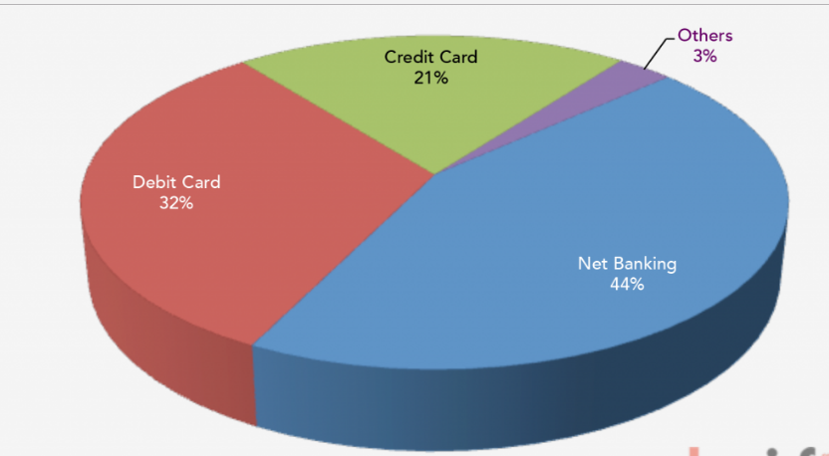
3. Financial Exchanges:
E-Commerce or Electronics Commerce sites use cash and electronic payment where electronic payment refers to paperless monetary transactions.
Electronic payment has revolutionized the business processing by various factors.
Example: Finding out the persons who made their purchases on various modes of payment by cash, credit card, debit card, Internet Banking NEFT.
DIGITAL PAYMENT GATEWAY INDIA

Slide 24
Financial Exchanges..
We have achieved the same in our project in various Tasks mentioned below.
Task 6: Sorting the whole file on the basis of amt.
Task 7: Finding the name of top 3 spenders.
Task 8: Finding the name of user who has spent the maximum amount.
Additional Enhancement: Finding the number of persons who made their purchase based on mode of payment.

Slide 25
4. Well-being Fitness:
We have to focus on Healthcare - both in terms of fitness and diseases outbreak.
Healthcare organizations are turning to data analysis to improve their care delivery and the cost of care. This services to this population to help fight the obesity.
EX: Identifying No of persons being physically fit i.e. finding their interest in exercise, gyms, yoga etc.
Additional & Future Enhancement:
We can implement the same in our project in various Tasks likes finding the total number of persons based on category of purchase.
Grouping the data based on Exercise & Fitness and Gymnastics.

Slide 26
5. Sports Awareness:
Sports and games form an essential part of human resource Development.
Sport development is a national priority, as it promotes active Lifestyle, child and youth development, social inclusiveness, Employment opportunities, peace and development, and above all a Sense of belongingness and national pride.
For example: Finding the number of person who is interest in various sports.
Additional & Future Enhancement:
We can implement the same in our project in various Tasks likes finding the total number of persons who were interest in various sports, we can group the persons in based on their interest.
Also we can find the maximum persons who were interested in particular sports.

Slide 27
Conclusion:
Data Analysis in E-Commerce can enhance various factors in terms of sales, transaction, communication with the customers.
The project analyzed the status of Economy, Seasonality, product selling, well-being Fitness, Financial exchange, Sports interest on factors like each age group and various period.

Slide 28
Project 2 Census Data Analysis for Development

Slide 29
Objective:
Census Data Analysis for Education status, Socio-Economic, Employment generation and Product selling.
This project would help in analyzing socio-economic status, employment and education on various factors like age group, citizenship, income, etc.
All the above would help in development of both individual and nation.

Slide 30
Given Data:
1. AgeGroup.dat:
Fields: Age and Group
2. Census_Records.json:
Age | Education | Marital Status | Gender | Tax Filer Status | Income | Parents | Country of Birth | Citizenship | Weeks Worked

Slide 31
HARDWARE & SOFTWARE REQUIREMENTS:
Operating System : LINUX
RAM : 8GB
System Type : 64 bit OS
Software Framework : Hadoop
Development Tool : Eclipse
Language Used : MapReduce Java, Hive, Pig

Slide 32
Census Analysis on following factors:
Education
Finance
Social
Citizenship and Immigrants
Employability
Product Selling & Others

Slide 33
Education:
Education means a lot in everyone’s life as it facilitates our learning, knowledge and skill. Education is must for both men and women equally as both together make a healthy and educated society.
An educated member certainly has a greater chance to contribute to his community.
Education helps you become an active member of the society and participate in the ongoing changes and developments.
For Example: Education status for each category of female and male. How many female adults have Bachelor's degree.
We have achieved the same in our project in various Tasks mentioned below.
1. Total count of male/female based on education.
2. Total count of employed/unemployed based on education.
3. Total count for people in age range of 18-25 based on education.

Slide 34
Finance:
Taxes are like income for the government so that they can pay for socialized services within your country for service such as health care, pension funds, welfare, homeland security, war, etc. The countries with extremely prosperous and the citizens have a high per capita income wants to pay the tax regularly.
For example, Count of Tax filer status for each category of citizenship, what is the count of non-filer of middle-aged female who is a Foreign born- Not a citizen of U S.
We have achieved the same in our project in various Tasks mentioned below.
1. Tax analysis total and gender wise
2. Per Capita Income (PCI) analysis consolidated, gender wise and category wise

Slide 35
Socio-economic status:
The government wants establish Pension schemes, Scholarship and special employment for the persons who were orphans, elderly, and female widowed.
Analyzing socio-economic status in for each age group and gender based on citizenship- Average income: Average hours an individual works.
We have achieved the same in our project in various Tasks mentioned below.
1. Total amount dispensed on pension in x year(s)(Data from user-Given Year:Validation)
2. Total amount dispensed on scholarship in current year(Data from user-Enter year)
3. For given age range employable female widowed and divorced count (Data from user Given min and Max age , with data Validation)

Slide 36
Citizenship and Immigrants
Analyzing various factors on both US citizenship and immigrants on various factors.
For example, how many non - United States born has acquired U S citizenship.
Count the total number of people whose Country of Birth is not United States and has citizenship as Foreign born- U S citizen by naturalization
We have achieved the same in our project in various Tasks mentioned below.
Citizens and immigrants count for employed lot
Non-US citizen(s) tax filer status
Country of birth wise count for US citizenship by naturalization

Slide 37
Employment Generation:
Analyzing qualification and gender in each category for employment.
For example, Count how many adult male have an education as some college but no degree and their average salary.
We have achieved the same in our project in various Tasks mentioned below.
For given age range employable female widowed and divorced count
Degree wise count for employability
Total count of employed/unemployed based on education.

Slide 38
Product Selling & Others:
Based on given data we can analysis selling of new product in the market also we can analysis factors like babies whose age less than 5 for vaccination, Orphan count with no education. Counting orphan who are not studying and based on their average income.
For example, count total infant whose parents are not in universe, have no education and their average income.
We have achieved the same in our project in various Tasks mentioned below.
Voter(s) count in x year(s)(Data from user->Enter the year)
Customer base analysis
Additional Tasks:
No of babies between age 0 to 5.

Slide 39
Conclusion:
Data Analysis in E-Commerce can enhance various factors in terms of sales, transaction, communication with the customers.
The project analyzed the status of Economy, Seasonality, product selling, well-being Fitness, Financial exchange, Sports interest on factors like each age group and various period.

Slide 40
Q & A

Slide 41
Thank you.

